Slide 1
The 3D Graphics Pipeline
D3D11 Day 2

Slide 2

The Fixed Function Pipeline*: (Early OpenGL & D3D)
LIGHT SETTINGS
DRAWING SETTINGS
MAGIC & STUFF
SWEET 3D PICTURE
VERTEX & INDEX DATA
OUTPUT OPTIONS
MODELVIEW MATRICIES
TEXTURES
*Fixed function pipeline did not actually contain magic. Just seemed that way.

Slide 3

The Programmable Pipeline: (Recent OpenGL & D3D)
VERTEX & INDEX DATA
VERTEX SHADER
RASTERIZER
AWESOME 3D PICTURE
DEPTH
STENCIL
SCISSOR
ALPHA
PIXEL SHADER
TEXTURE DATA

Slide 4


The D3D11 Pipeline
VRAM: Buffers, Constant Buffers, Textures. Read & Write.
Stream Output
Input Assembler
Vertex Shader
Hull Shader
Tessellator
Domain Shader
Geometry Shader
Rasterizer Stage
Pixel Shader
Output Merger

Slide 5
The Input Assembler Stage
You have already had some experience with this stage.
Input Layouts and Vertex Buffers are connected to this stage as a way to provide data to the rest of the pipeline.
Another type of buffer you can connect is an Index Buffer which we will learn about a bit later.

Slide 6
The Vertex Shader Stage
This is the first programmable stage.
You can write code in a language called HLSL to directly manipulate the vertex data before it moves to the next stage.
This code is known as a “Shader” it takes the form of a function designed to run across all the outgoing data in parallel.

Slide 7
The Rasterizer Stage
Wait… didn’t you skip a stage or 3?
Yep, those stages are optional and we will learn about them another time.
This Stage converts “NDC Space” geometry into pixel/fragment data via Rasterization.(More on this later)
This stage is NOT programmable, although it IS configurable.
Use it to control things like back-face culling, and Fill Modes like wire-frame.

Slide 8
The Output Merger Stage
You skipped the Pixel Shader(not optional)
It is used to modify all rasterized pixels.
We will go into detail on it next time.
The job of the “OM” stage is to perform operations like blending colors (for transparency) and determining which pixels are visible based on Stencil and Zbuffer values.
Think of it as a per-pixel filter and/or combiner.
We will go over the Z/Stencil buffer today.

Slide 9
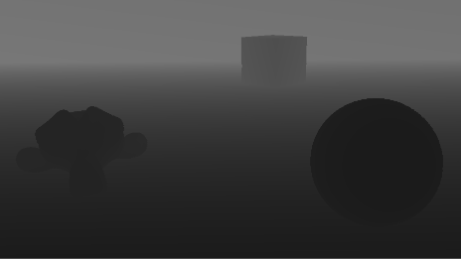
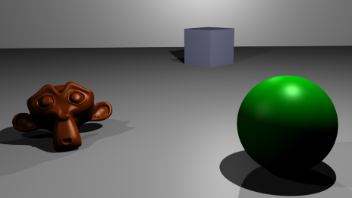
Output Merger: The Z Buffer
The Z Buffer or Depth Buffer is a 2D array in VRAM that records depth values of pixels when rasterized.
The Z Buffer keeps objects in a scene ordered correctly when rendering. (Far away objects are drawn behind closer objects)
Typically a floating point value from 0.0 to 1.0 is used to represent the depth in the scene per pixel. (0.0 being closest and 1.0 being farthest away)
The Output Merger Stage can use these values to discard pixels that are behind other pixels and cannot be seen.

Slide 10
The Z Buffer: Setup
The Depth Buffer is a special kind of ID3D11Texture2D.
Use the function “ID3D11Device::CreateTexture2D” to make it. The following settings can be used to make a typical depth buffer.
BindFlags:
D3D11_BIND_DEPTH_STENCIL
Format:
DXGI_FORMAT_D32_FLOAT
Just like the back buffer, we need an interface that allows us to bind this resource to the pipeline.
ID3D11DepthStencilView
You can bind the Z buffer at the same time you bind the ID3D11RenderTargetView to the pipeline.
Just like the back-buffer, be sure to “Clear” the Zbuffer.

Slide 11
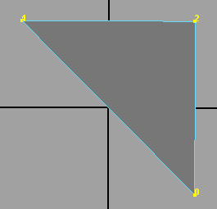
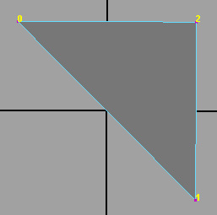
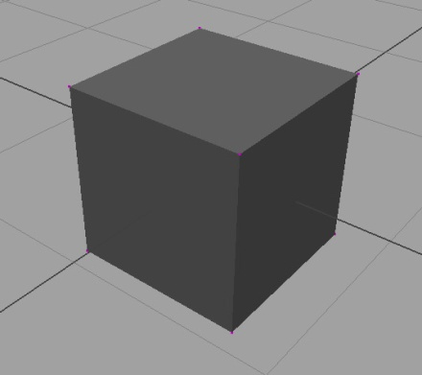
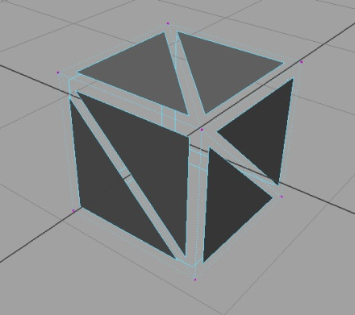
Geometry: Back-Face Culling
The way you order your vertex data when forming primitives is important.
The order you place the vertices in, either clockwise or counter-clockwise determines from what direction a triangle is visible.
This optimization allows triangles inside an object to be rejected during the drawing process.
This is known as backface culling, D3D has three culling modes. CW, CCW, and NONE. By default the culling mode is set to CCW.
CW
CCW

Slide 12
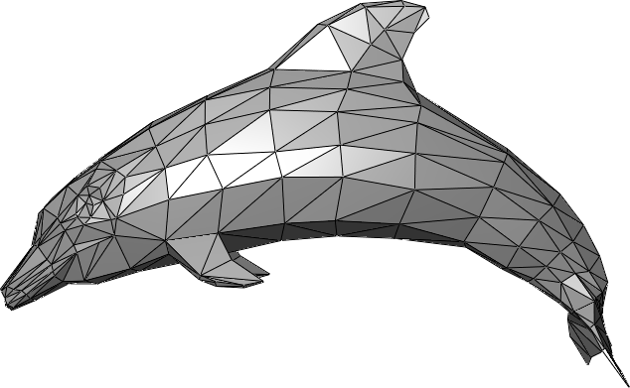
Geometry: Compression
Most of the time we usually don’t render just a single triangle, models are typically made up of thousands of triangles.
Because most triangles are connected to one another, they will share many vertices across the surface of the models geometry.
Without some form of compression/reuse each triangle would have to define its own copy of a vertex that has already been described by another adjacent triangle.
500 TRIANGLES TOTAL
1500 VERTS REQUIRED TO DESCRIBE EVERY TRIANGLE
ONLY 350 OF THOSE VERTS ARE ACTUALLY DIFFERENT

Slide 13
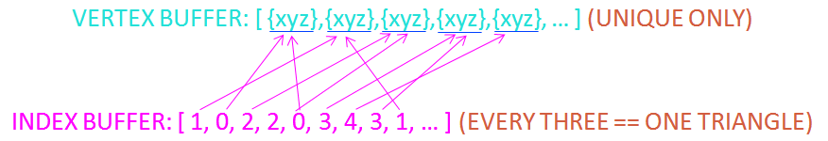
Indexed Geometry
An easy way to solve this problem, is to first describe all the unique vertices in an object without regard to triangle formation.
Rather than defining each triangle sequentially in the vertex buffer, we simply move this step to a secondary buffer that uses array locations from the vertex buffer to describe how the triangles are formed.
By doing this, we can now refer to a vertex multiple times in the secondary buffer by its array location rather than being forced to duplicate it each time we need it.
The savings come from needing far fewer vertices in our vertex buffer to describe all the triangles in the mesh. Instead of duplicating vertices, we now just copy indexes.

Slide 14
Index Buffers
Use an ID3D11Buffer but set the bind type to: D3D11_BIND_INDEX_BUFFER.
Fill the buffer with either unsigned integers or unsigned shorts depending on how many vertices you will need to reference.
Bind the buffer to the Input Assembler stage just like you would a vertex buffer.
Now you can use the function “DrawIndexed” instead of just “Draw”.

Slide 15
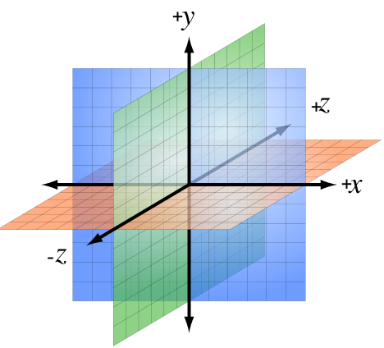
D3D Cartesian Coordinates
Although D3D can support multiple coordinate systems, typically we use a left handed system as pictured.
Many other API’s and Software packages have different setups. (OpenGL, Maya, 3DS Max)

Slide 16
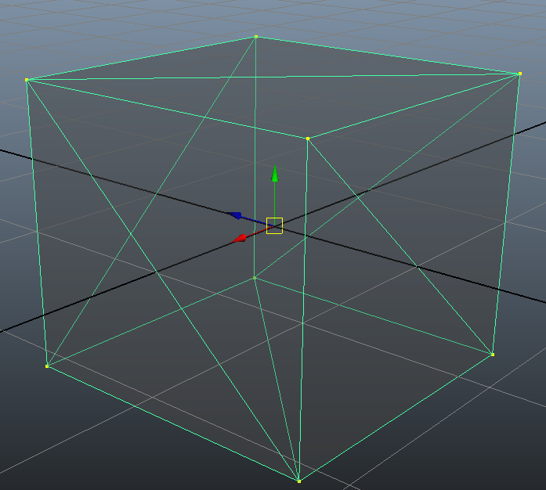
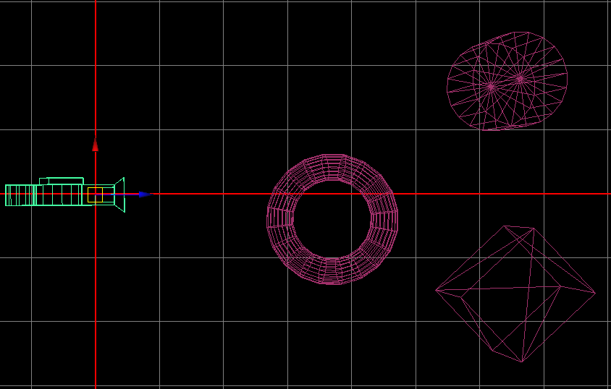
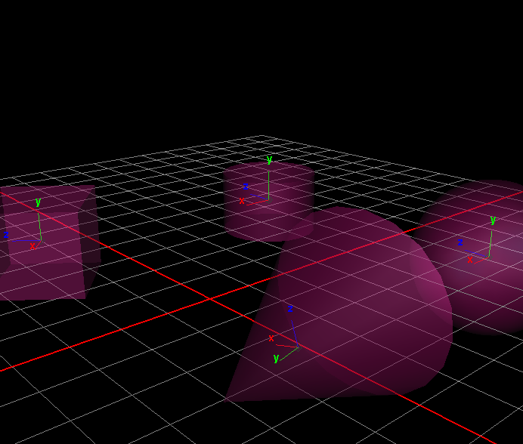
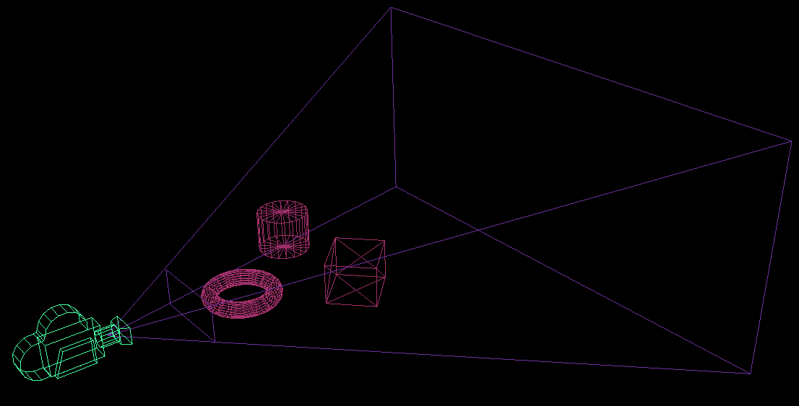
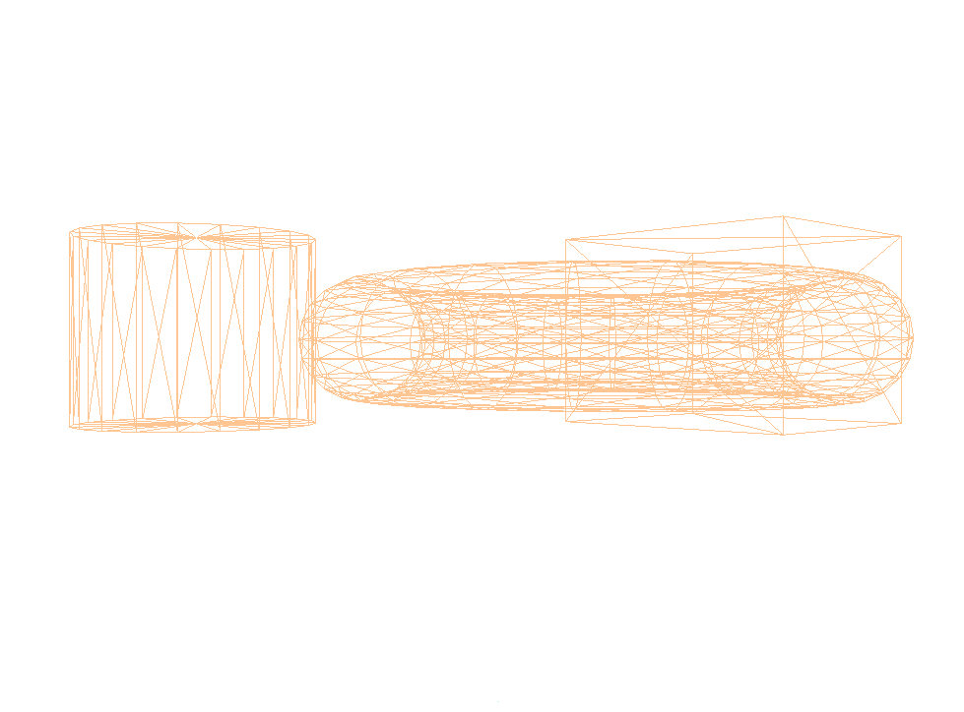
Space: From 3D to 2D
LOCAL/OBJECT SPACE
WORLD/GLOBAL SPACE
VIEW/CAMERA SPACE
VIEW/CAMERA SPACE PROJECTED
CLIP SPACE

Slide 17
3D Space: Local Space
The space in which your vertex data is typically defined.
It is the space that represents how all the vertices in a mesh are relative to one another.
The origin represents the point you wish your vertex data to translate, rotate and scale about once it is moved into world space.

Slide 18
3D Space: World Space
The space where the various 3D objects are described and manipulated.
It is the space that represents how the various 3D objects are relative to one another.
By multiplying your local space vertices by a matrix you move them away from the origin and into world space.
Even away from the origin an object still continues to have it’s own local space. The pivots in this image represent that space.
This is important because often we wish to manipulate an object in world space based on the object’s own local orientation in the world.

Slide 19
3D Space: View Space
View/Camera space defines how world space objects are relative to a camera/viewer.
A Camera could be considered just another world space object.
This means a camera is simply a matrix with a position and orientation from which we “View” the scene.
What makes it a “Camera” is the fact that we INVERT its matrix so when other matrices multiply by it, they end up relative to the camera’s world.

Slide 20
Homogenous Projection Space
Projection space prepares the 3D data to be flattened onto a 2D surface.
There are two common ways to project 3D data: “Perspective” and “Orthographic”. A perspective projection is shown above.
Refer to the day 4 slides on how to build this matrix.

Slide 21
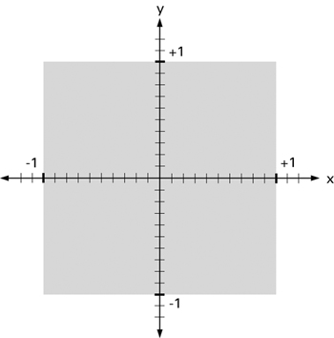
3D/2D Space: NDC Space
The rasterizer expects pre-projected (pre-W-divide) Homogenous coordinates. (Projection Space)
The space where our geometry finally ends up is called NDC Space. (XYZ/W)
NDC: Normalized Device Coordinates. The W divide itself is actually performed by the rasterizer stage. (Not the Vertex Shader!)
Now that the 3D polygons can be interpreted as 2D shapes, the hardware can convert them to pixels during the Rasterizer Stage.
If a shape goes outside of this space (shown in top image) it will be discarded or “clipped”.

Slide 22
Journey of a Vertex through Space
Local/Object Space
Where the vertex is defined (stored in Vertex Buffer, Vertex Shader Input)
World/Global Space
Vertex is then transformed by the objects world matrix to enter world space. (Vertex Shader Step 1)
View/Camera Space
From world space, vertex transformed relative to the camera’s matrix. (Vertex Shader Step 2)
Projection->NDC Space
Once a vertex is relative to the point of view, we scale the 3D vertex by the projection matrix allowing the position to be projected into NDC space. (Vertex Shader Output)

Slide 23
HLSL
High Level Shading Language
C style language used to write the various kinds of shaders used to control the pipeline stages.
6 kinds of Shaders: Vertex, Hull, Domain, Geometry, Pixel, Compute.
We will focus on HLSL syntax and Vertex shaders today.

Slide 24
HLSL: Base Data types
Scalar Types: (single component)
int, uint, float.
Vector Types: (1 to 4 components)
uint2, int3, float4.
Matrix Types: (2 to 16 components)
uint2x3, float4x4.
All of the above data types may be packed into structures.
Like C++ this enables functions to return more than just one type of variable.

Slide 25
HLSL: Resource Slot Types
These types are meant to be directly connected to their counterparts on the C++ side of the API.
Constant Buffers: (various fixed data)
cbuffer MyData : register( b0 )
{ float3 someDir; float aScalar; };
Texture Objects: (special types of buffers)
texture1(2or3)D and textureCUBE MyTexture : register( t0 );
Samplers: (used by textures)
sampler MySampler : register( s0 );
Buffers: (common ones, there are many more)
Buffer<baseType> MyReadBasic : register( t0 );
RWBuffer<baseType> MyWriteBasic : register( u0 );
StructuredBuffer<myType> MyReadComplex : register( t0 );
RWStructuredBuffer<myType> MyWriteComplex : register( u0 );

Slide 26
HLSL: System Semantics
Special Keywords that direct shader data throughout the pipeline. Input and Output.
Keep in mind that shaders do not replace the pipeline, they exist to manipulate data as it moves through it.
Here are some common system semantics and their effect on the pipeline.
SV_POSITION
Expected by the Rasterizer Stage, should contain a 4 component homogenous projection space position that will be converted to clip space via XYZ/W.
POSITION(0-32)
Typically used to identify local space XYZ vertex data that will come into the vertex shader.
TEXCOORD(0-32)
This semantic is used to pass texture coordinates all the way from the Input Assembler to the Pixel Shader Stage. Because it can move so far across the pipeline, it is often used to pass custom data to the next stage of the pipeline as well.
You may have seen “POSITION” and “TEXCOORD” before. Recall the ID3D11InputLayout? That is how we “connect” together the data in our Vertex Buffers to our Vertex Shaders input.

Slide 27
Sample Vertex Shader
struct V_IN
{
float3 posL : POSITION;
};
struct V_OUT
{
float4 posH : SV_POSITION;
};
cbuffer OBJECT : register( b0 )
{
float4x4 worldMatrix;
}
cbuffer SCENE : register( b1 )
{
float4x4 viewMatrix;
float4x4 projectionMatrix;
}
V_OUT main( V_IN input )
{
V_OUT output = (V_OUT)0;
// ensures translation is preserved during matrix multiply
float4 localH = float4(input.posL,1);
// move local space vertex from vertex buffer into world space.
localH = mul(localH, worldMatrix);
// TODO: Move into view space, then projection space
return output; // send projected vertex to the rasterizer stage
}

Slide 28
Tips For Lab:
Confused about cameras? Don’t be! Make a world matrix, move it and rotate it so the Z axis points at what you want to look at. Now INVERT it! Presto: Instant View Matrix.
Check out some of the extra slides after this one for more details on transformations.
Building 3D shapes in your head can be a pain, use pencil and paper to make life a little easier!
Finally making your own constant buffers? Great! But watch out for HLSL padding rules! If you use only float4 types you will be fine for now. I will go into detail on these rules at a later time.

Slide 29
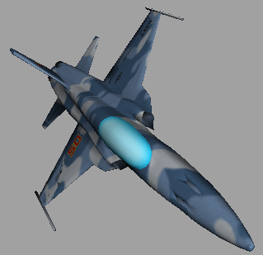
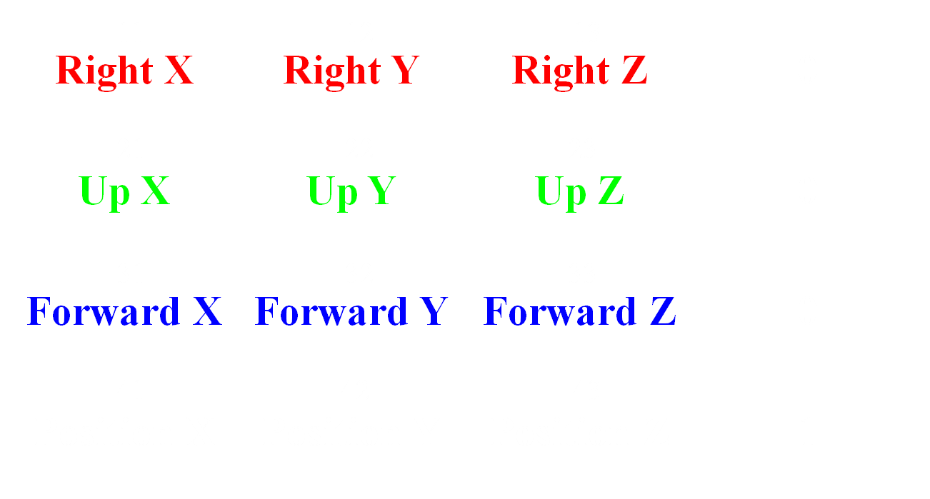
Local Axis: Vectors in a Matrix
Position XYZ += Distance * Right or Up or Forward XYZ

Slide 30
The View Matrix
Also known simply as the Camera, the view matrix’s main purpose is to take world space data and make it relative to a camera described in world space.
Any orthogonal world space matrix can be converted into a view matrix and vice versa. This is an important property of matrix behavior. If you have multiple matrices in the same space, you can select one of them and place all the other ones into it’s space by multiplying them by the inverse of that matrix.
View Matrix == Inverse World Matrix
World Matrix == Inverse View Matrix
Please keep in mind the camera is still simply a matrix, it describes a location and an orientation for a point of view. Things like FOV (field of view) and View Distance (far plane) are controlled by the projection matrix.

Slide 31
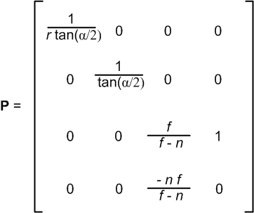
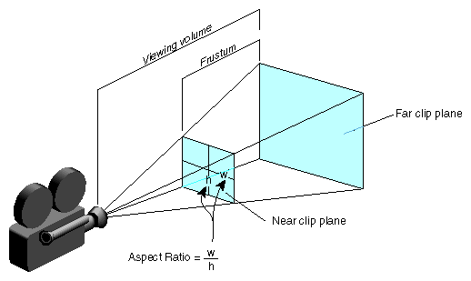
The Projection Matrix
The job of the projection matrix is to the scale the 3D view space vertices so they can be properly projected into clip space. This is done by describing a frustum that contains the 3D data you wish to project.
Some common ways to describe this frustum:
Field of View (how wide or narrow the angle of the frustum)
Far Clip Plane (Maximum distance of a visible vertex in View Space)
Near Clip Plane (Minimum distance, also where we will project onto)
Aspect Ratio (Relationship between a frustum’s height & width)
r = width/height ratio
α = field of view angle
f = Dist to far plane
n = Dist to near plane
*All dist in View Space

Slide 32
HELP! HELP! HELP!
Utterly Lost? MSDN to the Rescue!!!
For learning only!!!(do NOT copy paste)
Seriously! Don’t turn these in!(Face-palm)

